Slide 1
Safety on the Inside: How to Effectively Support Behavioral Health in the Construction Industry
Richard Jones, Chief Clinical Officer, Youturn Health

Slide 2
Richard Jones, MA, MBA, LCAS, CCS, CCDP, CAI
Chief Clinical Officer, Youturn Health
Richard Jones is an experienced therapist, clinician, and healthcare entrepreneur operating primarily in the behavioral health space. Richard has wide-ranging professional experience across nearly all behavioral health domains, including mental health, substance use disorders, co-occurring disorders, and intellectual disabilities.
He has over 20 years of management experience and has been instrumental in the launch and rebuild of multiple programs nationwide. Richard is passionate about providing quality care and supporting people in need. He has been the founding CEO of two non-profit organizations and two for-profit business dedicated to disrupting the behavioral health space for the betterment of people in need.
2

Slide 3
Behavioral Health
Refers to mental health and substance use disorders, life stressors and crises, and stress-related physical symptoms. Behavioral health care refers to the prevention, diagnosis and treatment of those conditions.
  Enables people to realize their abilities, learn well, and work well
  Not simply the absence of mental illness/substance use disorder
  Exists on a continuum
  Our mental health influences – everything:
    How we think
    How we act
    How we feel
    How we manage stress
    How we relate to other people
3

Slide 4
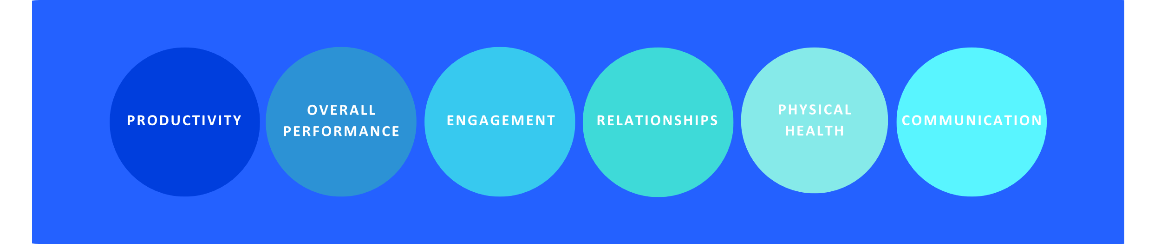
The Impact of Behavioral Health
4

Slide 5
What’s the Problem?
5

Slide 6

“
In 2021, 94% of people with a substance use disorder (SUD) did NOT receive help for their SUD.
”
Source: SAMHSA National Survey of Drug Use and Health (NSDUH), January 4, 2023. https://www.samhsa.gov/data/release/2021-national-survey-drug-use-and-health-nsduh-releases

Slide 7
“
In 2021, only 6% of people with a substance use disorder (SUD) received help for their SUD.
”
Source: SAMHSA National Survey of Drug Use and Health (NSDUH), January 4, 2023. https://www.samhsa.gov/data/release/2021-national-survey-drug-use-and-health-nsduh-releases

Slide 8
43.7 Million in Need of Treatment
3 million people
No treatment
Treatment
40.7 million people
Source: SAMHSA National Survey of Drug Use and Health (NSDUH), January 4, 2023. https://www.samhsa.gov/data/release/2021-national-survey-drug-use-and-health-nsduh-releases

Slide 9
Why Don’t People Receive Treatment?
1.1%
2.1%
Didn’t feel they needed it
Knew they needed treatment but didn’t try to get it
96.8%
Tried but couldn’t get treatment
Source: SAMHSA National Survey of Drug Use and Health (NSDUH), January 4, 2023. https://www.samhsa.gov/data/release/2021-national-survey-drug-use-and-health-nsduh-releases

Slide 10
Industries with the highest risk of suicide have the following factors…
Epidemic of Suicide in Construction
A male-dominated workforce
A widespread substance abuse problem
A shift work system
Access to a lethal means for suicide
Fearlessness in a risk-taking environment
10

Slide 11
The Numbers per 100,000
5X
17X
9.4
National Construction Fatality Rate (BLS)
53.3
Deaths by Suicide
(CDC)
162.6
Deaths by Overdose
(CDC)
BLS & CDC.gov
11

Slide 12

Behavioral Health in the Construction Industry
12%
of construction workers have an alcohol use disorder
20%
of Americans who die by suicide are construction industry workers
25%
of fatal opioid overdoses among workers are from the construction industry
80%
of construction workers have experienced stress at work
12

Slide 13
Staggering Statistics
“A record-breaking 105,000 people died of an overdose in 2021 in the midst of the COVID-19 pandemic, the U.S. government reported...” ¹
Translates to an average of more than 250 people dying each day, or roughly 12 every hour
The odds of dying from an opioid overdose are now greater than those of dying in a car crash.
NSC survey shows that 75% of workplaces are impacted by opioid use.
75% of people with a Substance Use Disorder are in the workforce
13

Slide 14
Cultural Influences
Being tough and strong are emphasized and highly valued
Deadline-driven work
Limited control for the individual worker
Construction Industry
Long hours and time away from family
Financial strain
(e.g., seasonal work, inconsistency)
Chronic pain from highly physical nature of the work
14

Slide 15
The Impact
Employer Impact
SUD
ROI
Employers spend, on average, over
$15,000 more a year
on employees who experience mental distress
Mentally distressed workers are nearly
3 ½ times more likely
then their peers to have substance use disorders
For every
$1 invested in mental health treatment,
there is a $4 return in improved health and productivity
New studies project a $7:$1 ROI.
*Statistics According to the National Safety Council
15

Slide 16
Gaps in the Treatment of Behavioral Health
Asking for Help
Only a small percentage of individuals ever reach out for help
What about those struggling that will never reach traditional support or treatment?
Family Support
Overall, the family is not well supported
The focus is on the individual (which makes sense), but there is a tremendous need for family support
Engagement
75% of people who remain engaged (no matter what treatment modality) will reach recovery or remission
Problem: People do not remain committed and engaged in the process
16

Slide 17
Best Practices: Taking a Comprehensive Approach
17

Slide 18
Key Signs of a Behavioral Health Challenge
Observe behaviors, appearance, feelings, and thoughts
Behaviors:
Coming in late, leaving early, arguing, disengaging, canceling, withdrawing
Appearance:
Disheveled clothing, unkept, looking tired
Feelings:
Worrying excessively, sad, irritated, no longer interested in hobbies, hopelessness
Thoughts:
Concentration or focusing issues, being very indecisive, self-blame or criticism, hopelessness
18

Slide 19
Workplace Best Practices
Review Workplace Drug Policy
Provide Employee Education on Behavioral Health
Update Policies and Programs Annually to Reflect Key Initiatives
Ensure Your Organization is Deriving Engagement and Outcomes from Programs in Place
19
Notes:
The Basics: Include a drug testing policy, available programs, and rules all for employees. This will significantly mitigate future risk and clear expectations.
Delivery: Review the workplace's policy, program, and rules with new hires and existing employees annually. As new hires begin work, make the review part of their orientation package and include it on the company intranet or internal website. Provide information about substance use, the symptoms of drug use, and their effects on performance. You might also include information related to the use of medications and the employee's responsibility to be fit for duty
Discuss how employees and their families can get help through employee benefits – an Employee Assistance Program (EAP), a health and wellness program, employer-sponsored health care coverage, or other channels.
Explain HOW resources are confidential and how they are protected
Discuss prevention resources such as health and wellness programs, helplines, and other community resources. Explain how to seek assistance. Share resources available to the employee's family.
Create a culture of care. Motivate your employees to support the policy and the available programs by creating a shared sense of responsibility for the success of a drug-free workplace policy that support a drug-free workplace, health, and wellness.
Leverage multiple techniques (i.e., Lunch & Learns, webinars, and on the company’s intranet, as well as in a hard copy of the official employee handbook).
Require mandatory education certification for employees.
Learn from Employees
Consult with others to see what solutions will integrate well into your current program.
Develop a process to continually review and support health and wellness
What you MEASURE drives what you can CHANGE

Slide 20
Get Involved
Identify, promote, and measure existing programs in place
Recognize diverse needs and desires for support among employees
  Conduct needs assessments and explore the needs of employees when possible
Ensure that resources are easily accessible for all (e.g., different age groups, cultures, education levels, etc.)
Explain HOW resources are confidential and how they are protected
Leverage multiple engagement techniques (e.g., toolbox talks, training, wallet cards, stickers)
20

Slide 21
Innovative Ways to Change the Game
21

Slide 22
Gaps in the Treatment of Behavioral Health
Asking for Help
Only a small percentage of individuals ever reach out for help
What about those struggling that will never reach traditional support or treatment?
Family Support
Overall, the family is not well supported
The focus is on the individual (which makes sense), but there is a tremendous need for family support
Engagement
75% of people who remain engaged (no matter what treatment modality) will reach recovery or remission
Problem: People do not remain committed and engaged in the process
22

Slide 23
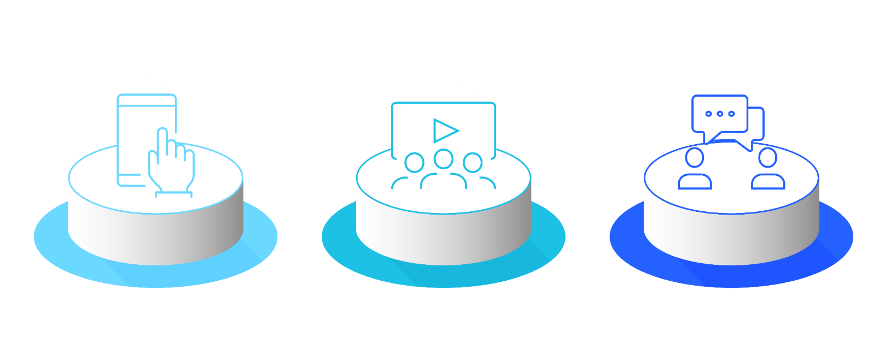
3 Paths to Success
Engagement
ACE Peer Coaching
Family Support
Confidential
Coaches paired on lived experience and demographics
Ongoing communications
Work with schedules via phone, text, FaceTime
Connect in the moment
Stick and Stay
Engage | Educate
Empower | Encourage
Family support is complimentary and includes specific marketing and engagement techniques to target family members.
3-5 minutes per video
35+ courses (stress management, recovery 101, etc.)
300+ lessons
24 critical conversations
Resilience Capital Index (RCI)
23

Slide 24

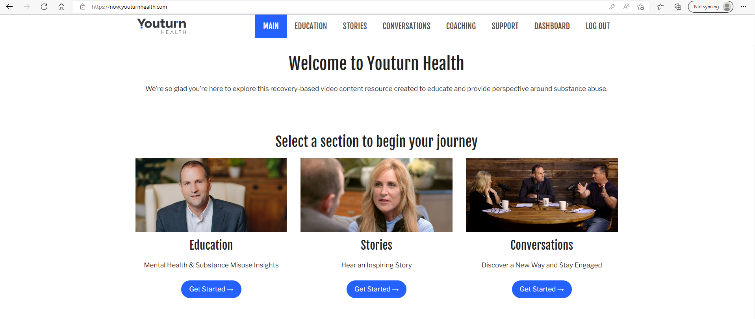

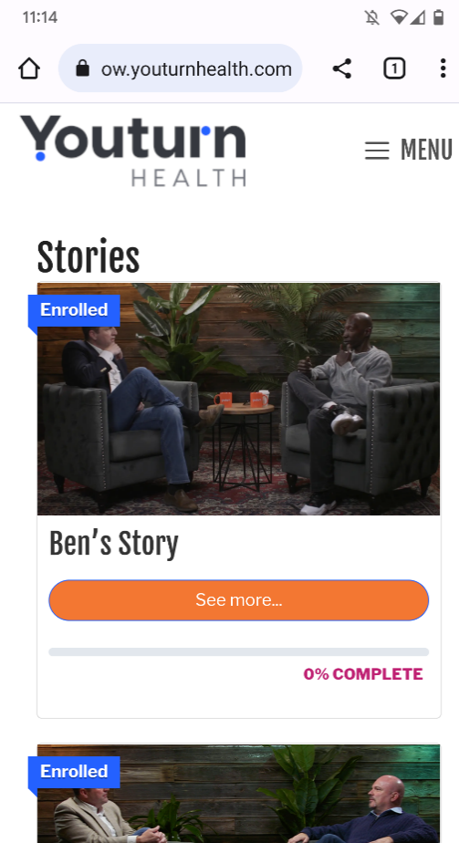
Online Education
24

Slide 25

ACE Peer Coaching & Family Support
Coaching Credentials
National Certification with NAADAC
Assertive Community Engagement (ACE) Coaching
Dedicated and Credentialed Family Coaches
Adherence to CFR-42 confidentiality laws and HIPAA privacy/reporting laws at federal and state level
Strategies
Regular and consistent touchpoints with participant
Referrals to providers and treatment
Help high-risk/crisis cases
Participant and Family Engagement
Paradigm shift: The professional is responsible for the engagement of the participant
Engagement
Establish consistent contact at appropriate level for participant
Meet participant where they are at
Collaborate with participant and family
25

Slide 26
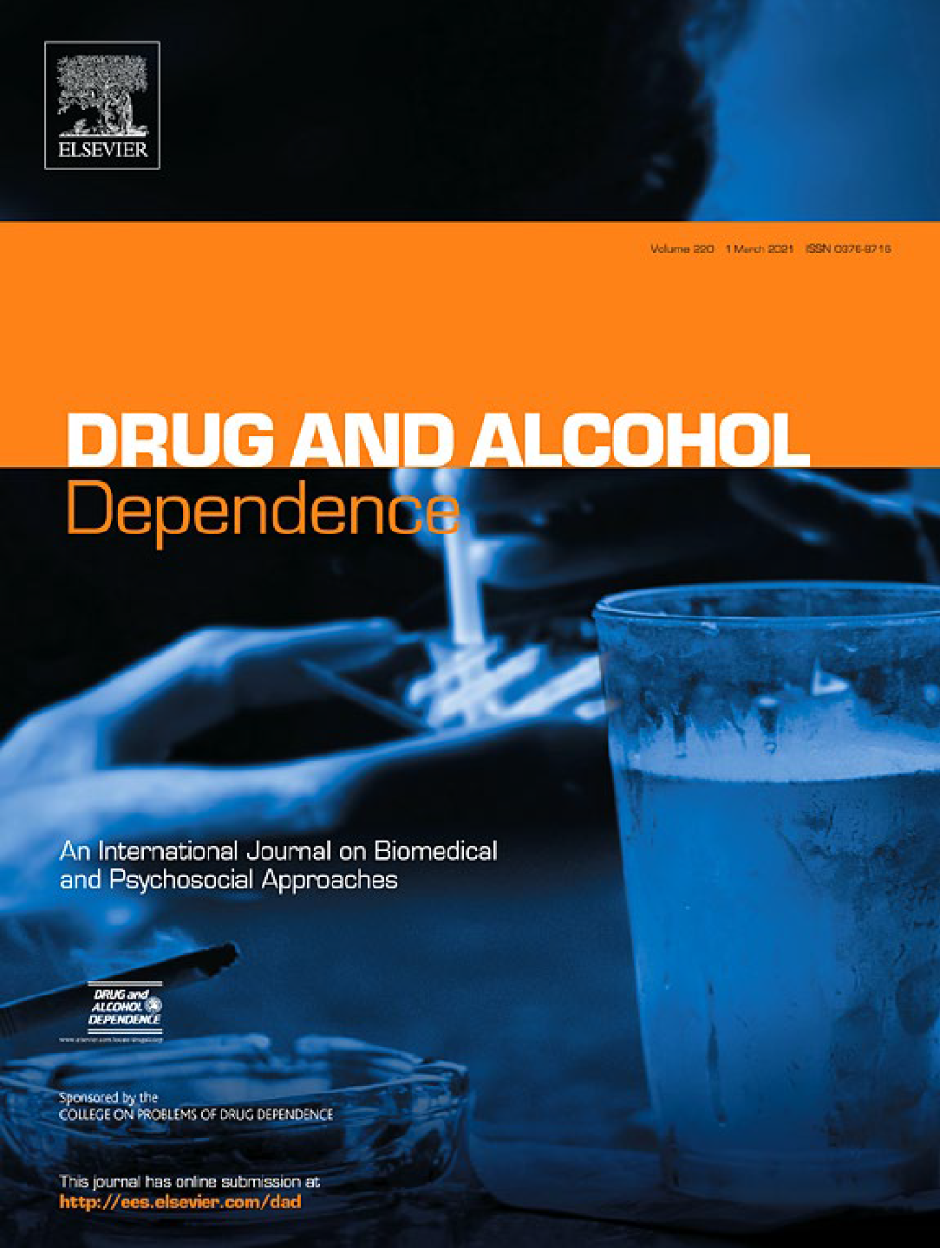


Results
1
0.9
0.8
0.7
0.6
0.5
Engagement Percentage
Intervention
Results
Engagement rate over the six-month post-discharge time period was higher for participants in the recovery coaching intervention (84%, 95% CI: 78% to 91%) compared to the standard of care control condition (34%, 95% CI: 25% to 44%), log OR = 28.95, p<.001.
Conclusion
SUD is a chronic, relapse-prone disease, and the most important factor for predicting improvement at five years post-discharge is on-going engagement (Weisner et al, 2003). This study demonstrates that inpatient linkage to recover coaching services improves engagement rates and can feasibly be implemented in a single large hospital system. This intervention is promising for both short-term and long-term engagement in recovery support services.
0.4
Control
0.3
0.2
0.1
0
Baseline
30-Day
60-Day
90-Day
6-Month
Time Point
Randomized Control Trial Results
When paired with a coach, participants had an 89% engagement in recovery versus traditional treatment at 10%.
Kaileigh A. Byrne, Prerana J. Roth, Krupa Merchant, Bryana Baginksi, Katie Robinson, Katy Dumas, James Collie, Benjamin Ramsey, Jen Cull, Leah Cooper, Matthew Churitch, Lior Rennert, Moonseong Heo, & Richard Jones | Clemson University, Prisma Health-Upstate, University of South Carolina School of Medicine Greenville
26

Slide 27
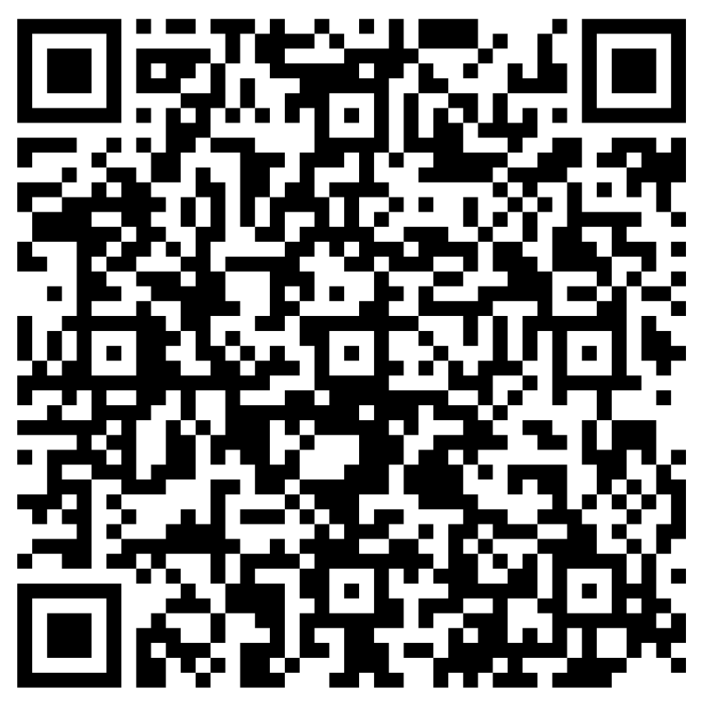

Slide 28
Your Commitment
Leadership, HR, Safety, Peer Groups
  Leadership and key influencer support increases program participation
  Referral coordination from HR, Leadership, Safety, and Peer Support
  Mandatory Trainings for Leadership/Identified Team
  Recovery First Aid, Mental Health Communication, Signs of Suicidal Ideation
Proprietary to the AGC Discount Program | Annual Fee
1-250 Employees | $5,000
251-750 Employees | $10,000
751-1,250 Employees | $15,000
1,251-2,000 Employees | $20,000
2,000+ Employees | Priced Upon Request
28

Slide 29





Q & A
Rich Jones
Chief Clinical Officer
Youturn Health
rjones@youturnhealth.com

Slide 30
References
Adams, T., & Nguyen, T. (2022). Mind the workplace 2022 report: Employer responsibility to employer mental health. Mental Health America
Beyer, Cal. (August 2021). Improving access to health care and wellness services for construction trade and craft workers. Construction Executive. https://www.constructionexec.com/article/improving-access-to-health-care-and-wellness-services-forconstruction-trade-and-craft-workers
Burleson, B. R. (2003). Emotional support skill. In J. O. Greene & B. R. Burleson (Eds.), Handbook of communication and social interaction skills (pp. 551–594). Mahwah, NJ: Lawrence Erlbaum.
CDC. (2023). About mental health. https://www.cdc.gov/mentalhealth/learn/index.htm
CDC. (2022, July 18). Partnering to prevent suicide in the construction industry – Building hope and a road to recovery. https://blogs.cdc.gov/niosh-science-blog/2020/09/09/suicide-in-construction/
High, A. C., & Dillard, J. P. (2012). A review and meta-analysis of person-centered messages and social support Outcomes. Communication Studies, 63(1), 99–118. https://doi.org/10.1080/10510974.2011.598208
Holt-Lunstad, J., Smith, T. B., Baker, M. D., Harris, T., & Stephenson, D. (2015). Loneliness and social isolation as risk factors for mortality. Perspectives on Psychological Science, 10(2), 227–237. https://doi.org/10.1177/1745691614568352
Lo Presti, A., Pappone, P., & Landolfi, A. (2019). The associations between workplace bullying and physical or psychological negative symptoms: Anxiety and depression as mediators. Europe’s Journal of Psychology, 15(4), 808–822. https://doi. org/10.5964/ejop.v15i4.1733
NAMI. (n.d.). Mental health conditions. https://nami.org/About-Mental-Illness/Mental-Health-Conditions
NIMH. (2022). Mental illness. National Institute of Mental Health. https://www. nimh.nih.gov/health/statistics/mental-illness
Pulse Survey Report. (2021). Mental health and wellbeing in the construction industry. https://www.workplacementalhealth.org/employer-resources/guides-and-toolkits/mental-health-and-well-being-in-the-construction-i
WHO. (2022). Mental health: Key facts. https://www.who.int/news-room/fact-sheets/detail/mental-health-strengthening-our-response
International Union of Painters and Allied Trades. Suicide is Taking its Toll in Construction. https://www.iupat.org/news/suicide-is-taking-its-toll-in-construction/
Construction Dive. Construction Remains One of the Deadliest Industries. https://www.constructiondive.com/news/construction-remains-among-top-deadliest-industries/639304/
National Vital Statistics Reports. Drug Overdose Mortality by Usual Occupation and Industry: 46 U.S. States and New York City, 2020. https://www.cdc.gov/nchs/data/nvsr/nvsr72/nvsr72-07.pdf
30

