Slide 1
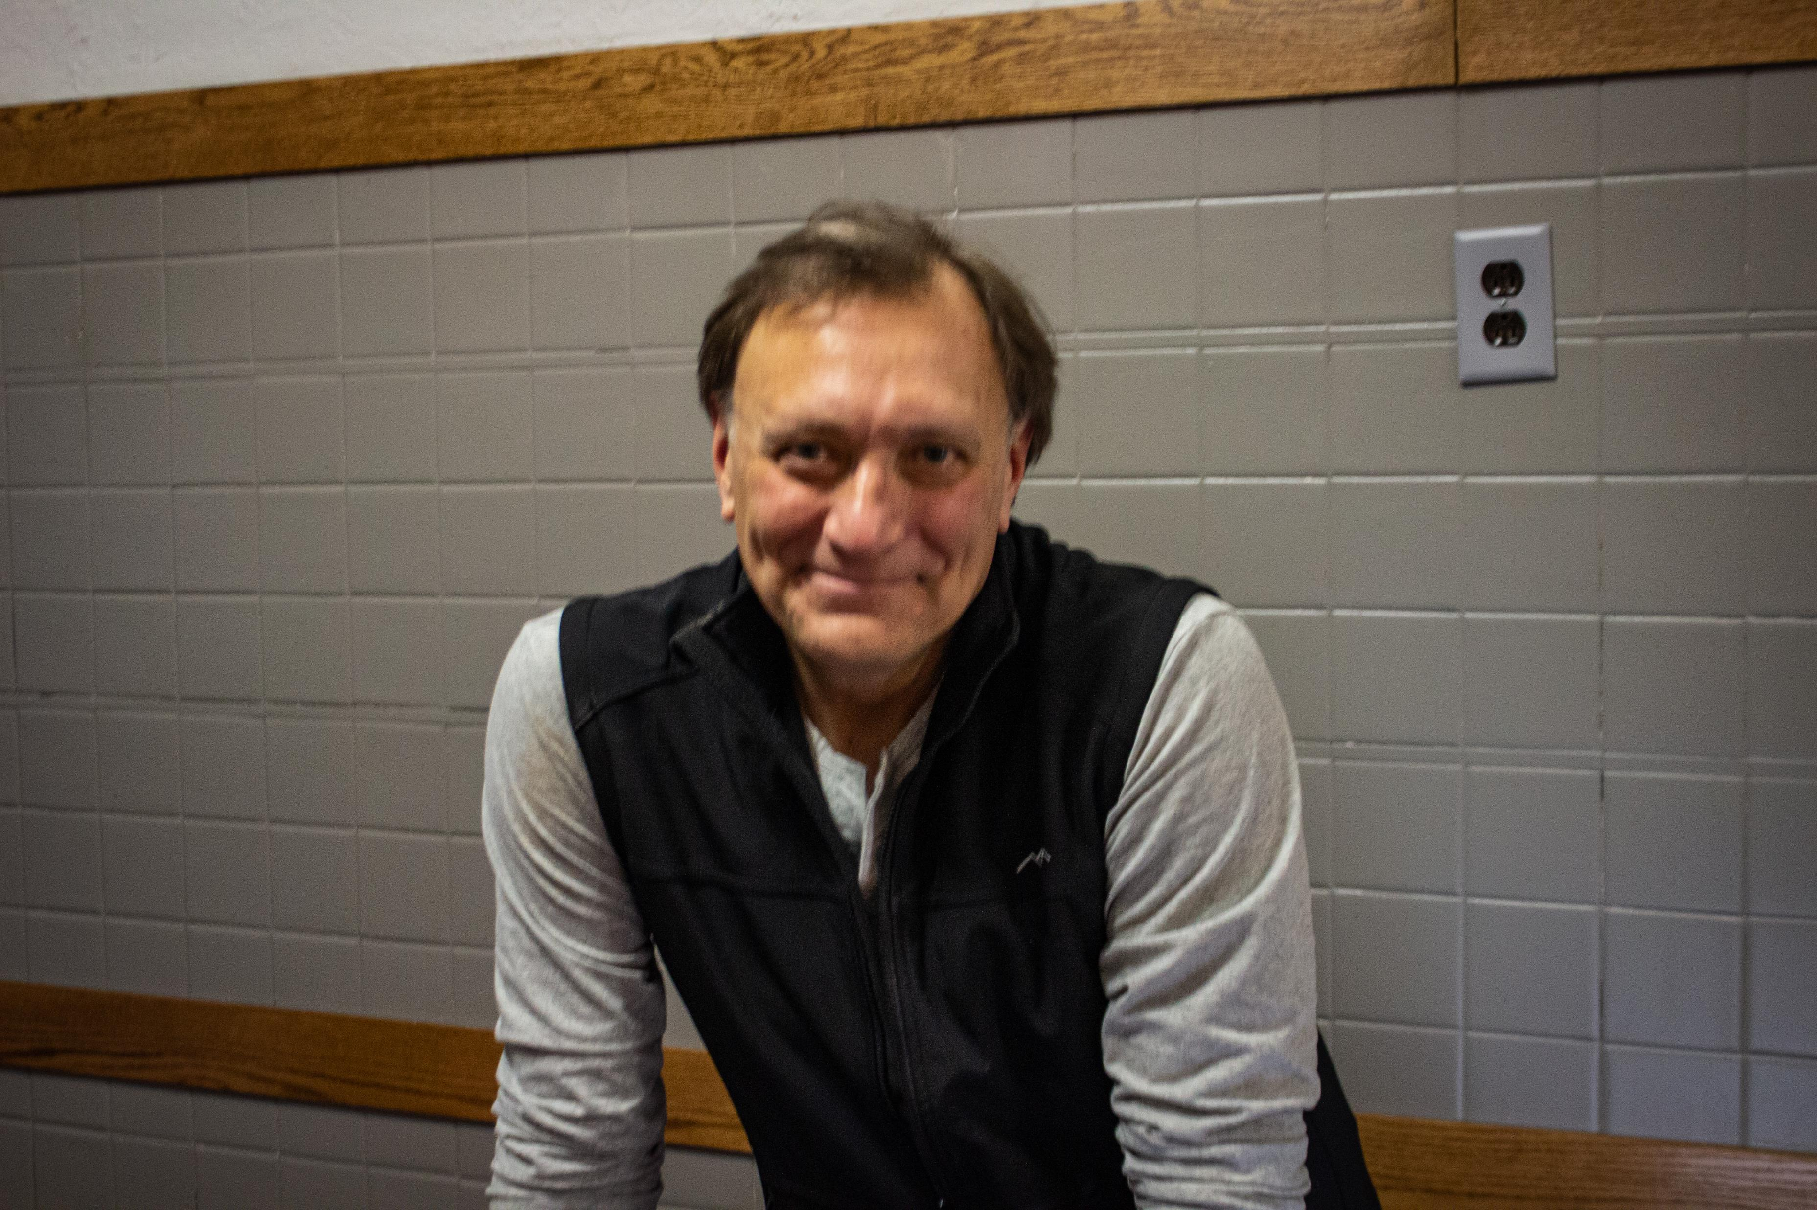
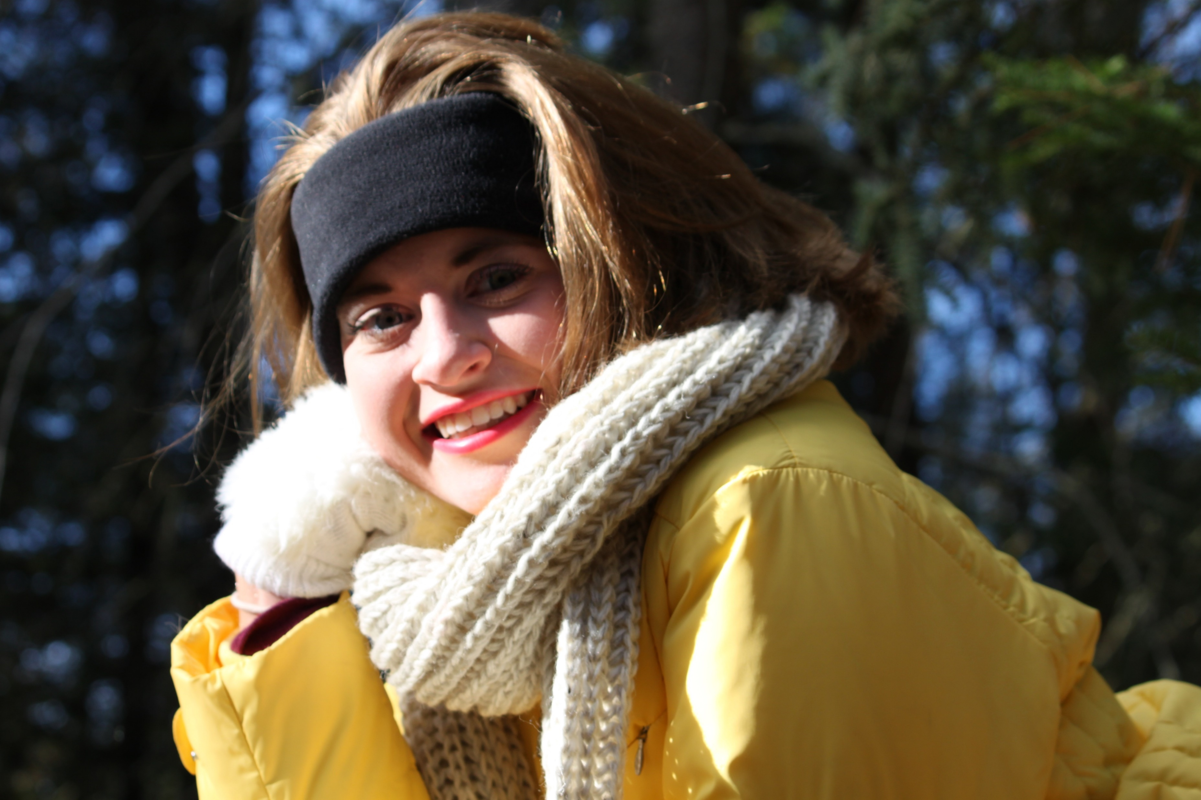


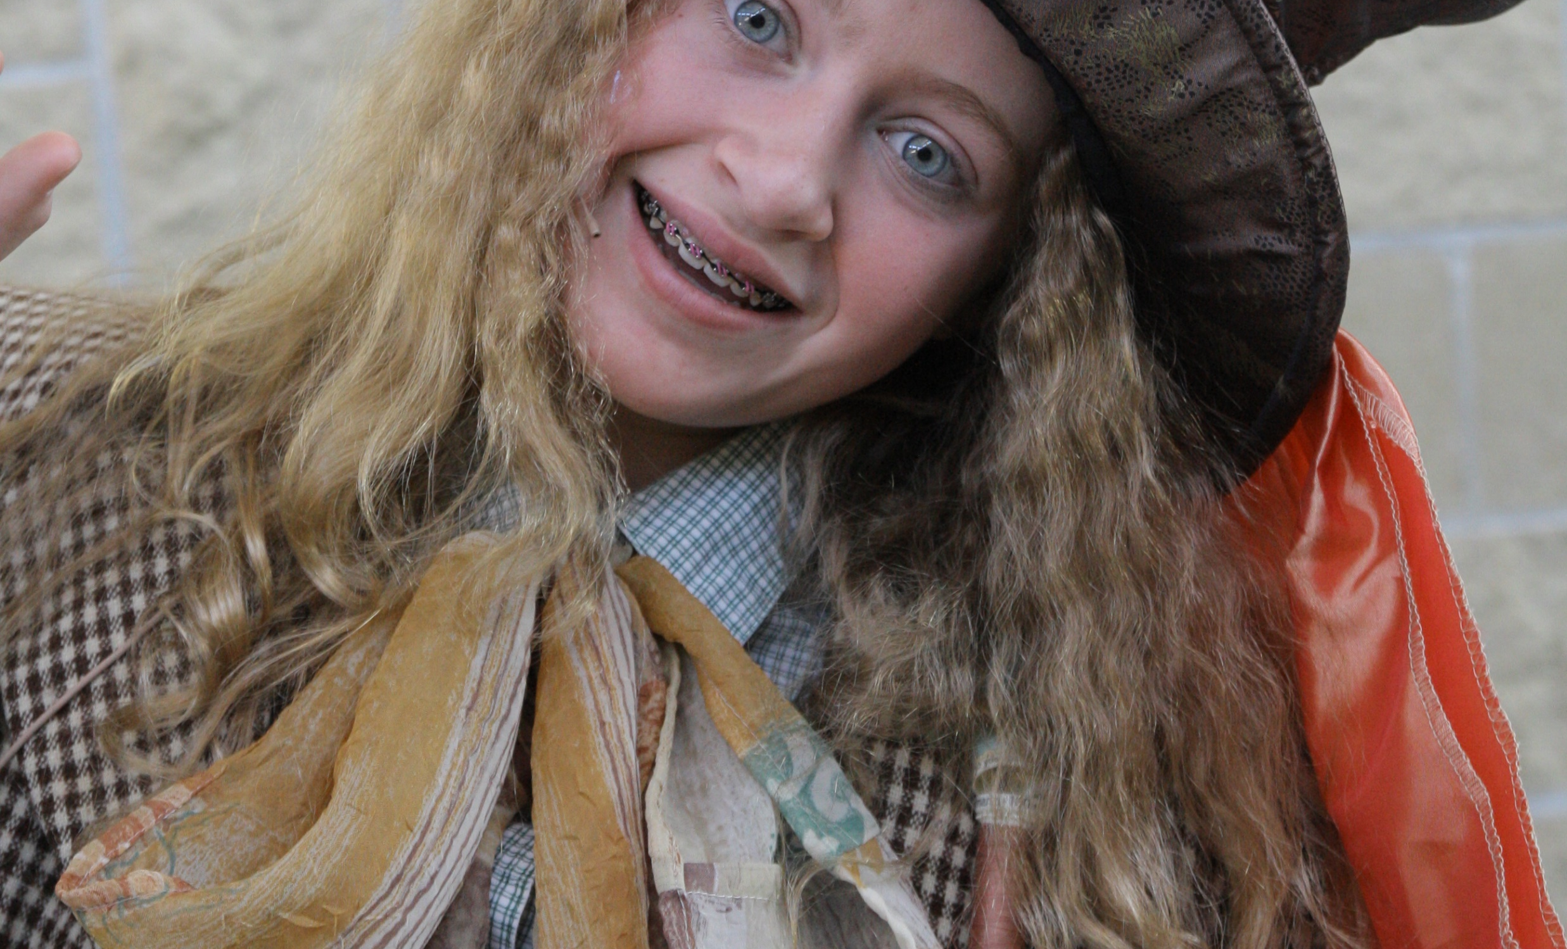
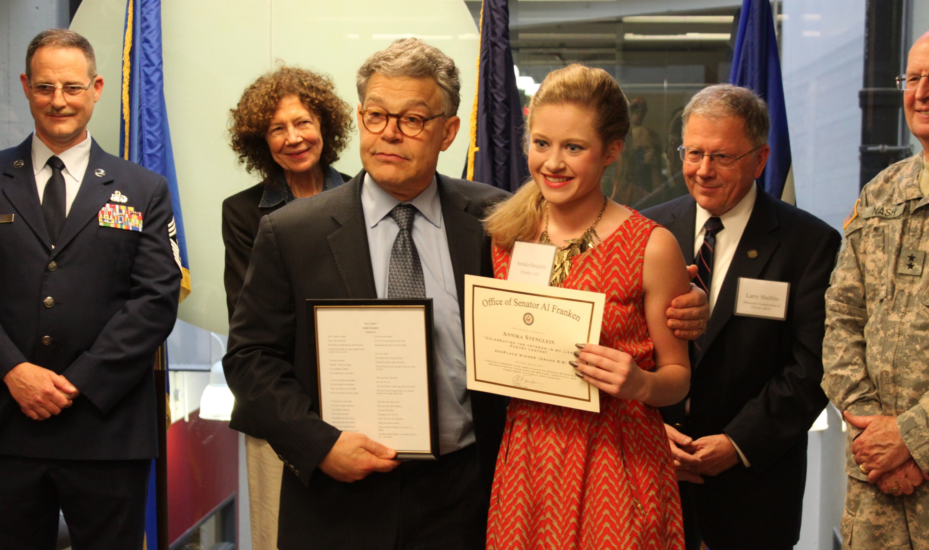
Ray Stenglein

Slide 2
Our story

Slide 3
Born and raised in Minneapolis,
Married love of my life in 1993, been married for over 30 years now
Moved out state/Rural Mn for past 31 years
Been in the Construction Industry for over 40 years
Mental health/ suicide not on my radar, including losing a carpenter to suicide
Raised a family, 2 beautiful daughters Madeline and Annika, very smart, athletic, played music instruments, Family camping and several week long vacations , a trip to Alaska

Slide 4
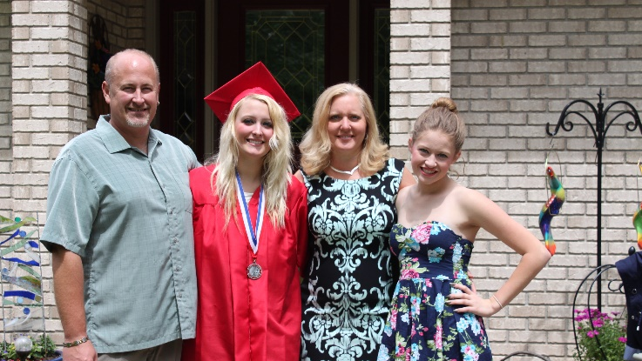

Slide 5
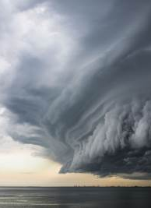
Our Storm

Slide 6
February Eldest daughter attempted suicide at age 15, (first of 4 attempts)
72 hour hold
What do we do now? No therapists around our county can see teenagers.
June of 2015 in patient for a eating disorder, then fall a second in patient stint. Learned brain development (25) and beyond
Waking in morning waiting for a sound or the light come on
Driving after work hours to be with the family dealing with this then heading back to the hotel
Spring 2015 Graduation (slide)
December of this year youngest started her journey with issues. Middle of freshman year
June her episodes worsened
Found herself with her love of theater and modeling, things were looking up
December 12…. 2016, she lost her battle with mental illness

Slide 7
Life after a suicide / Grief journey

Slide 8

PTSD Therapist/Therapy
Antidepressants
Alcohol misuse
Unsafe mentally at times on the job site
Never healed always healing
How to talk to someone who has a loss/ any loss
QPR/CPR
Say the phrase “Are you thinking of suicide”
Keep her story and her life alive

Slide 9
The biggest Danger in Construction Work is Poor Mental Health
The biggest Danger in Construction Work is Poor Mental Health

Slide 10

Suicide is the 10th leading cause of Death in New Mexico
Approximately 525 death by suicide in 2022 in New Mexico
This number is more likely greater as overdoses in drugs and alcohol can be a suicide completion but we will not know this unless a note was left.
heart disease, cancer, COVID-19, unintentional injuries, chronic lower respiratory disease, stroke, diabetes, chronic liver disease, Alzheimer's disease, and suicide

Slide 11
Estimates of attempted suicide
33 attempts for each documented death
(Note: 49,000 suicides translates into 1,617,000 attempts annually)

Slide 12

“When moments of crisis occur, people don’t often rise to the occasion, but they sink to their level of training.

Slide 13
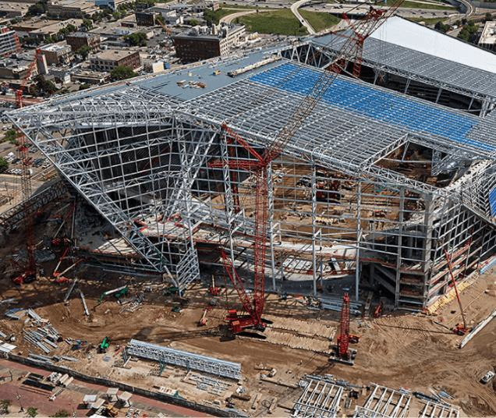
What we Shouldn’t do – focus on the end result:
  Suicide
What we need to do – is to focus on the upstream indicators:
  Build a Mentally Healthy Workforce

Slide 14

The majority of construction workers never express their feelings or seek help.
Nearly 60% of construction workers reported struggling with mental health
Only a third said they would communicate this to their employer or co worker
WHY
Fear of embarrassment , and a belief their employer wouldn’t be able to help
Over 60 % of students today are feeling depressed and anxiety… They are our future work force.
0ver 50% of students today are not interested in the construction field.
On average a person will struggle with MH for 10 years before seeking help or acting on.

Slide 15

Building a Mentally Healthy Workforce
The Business Case
Construction workforce shortage – Projected to exceed 500,000 workers in 2023:
  35% of workers who left construction indicate Mental Health reasons.
  25% of current workers are considering leaving construction because of Mental Health reasons.
    Lost productivity costs up to 27 days for each worker per year - $100 billion annually in the US:
      86% of workers who got help indicate improved work performance.

Slide 16

Shinning a Light
Suicide Rates Nationally (Per 100,000 workers)
5 times as many construction workers die by suicide each year than by all other construction-related fatalities
53.2
17.3
10.1
National
Average
Construction
Average
All Jobsite
Fatalities
That’s more than 5,500 construction workers

Slide 17
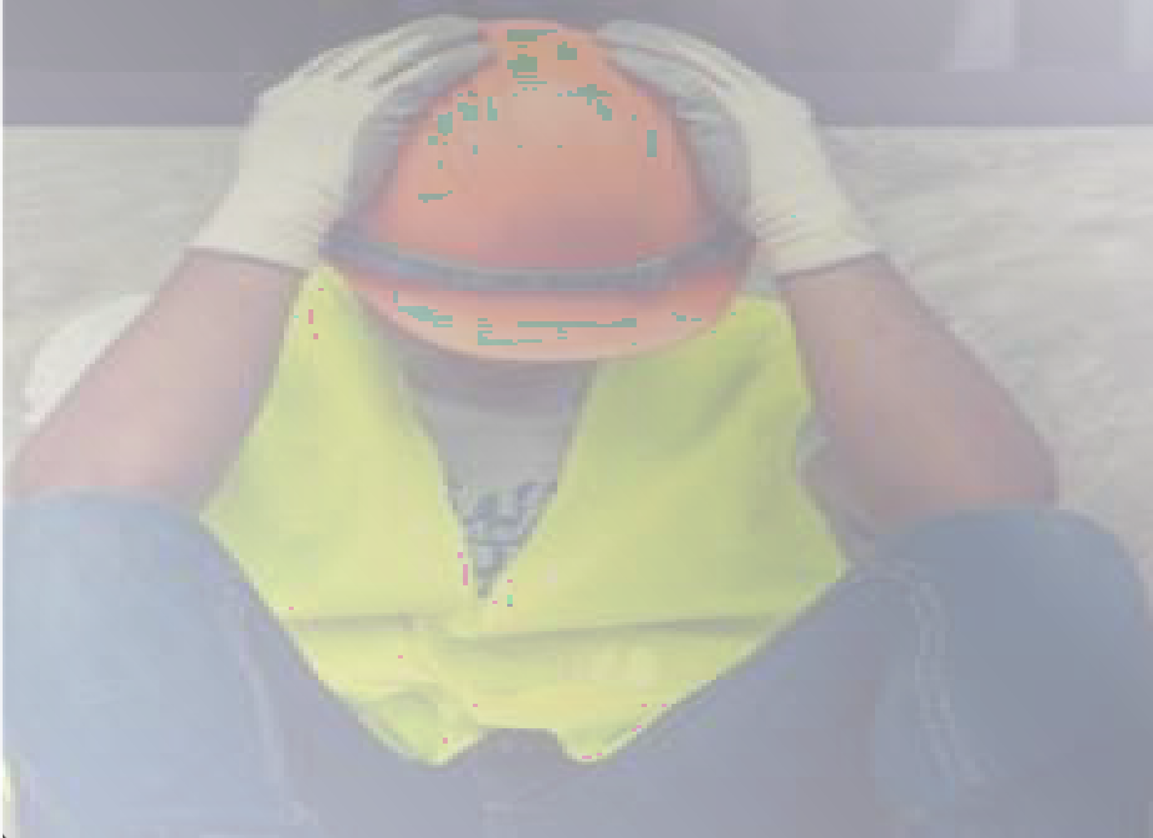
The First Place to Start?
As leaders, it begins with us.
Have the conversation with your workforce
Acknowledge the Challenge
Awareness to Action

Slide 18


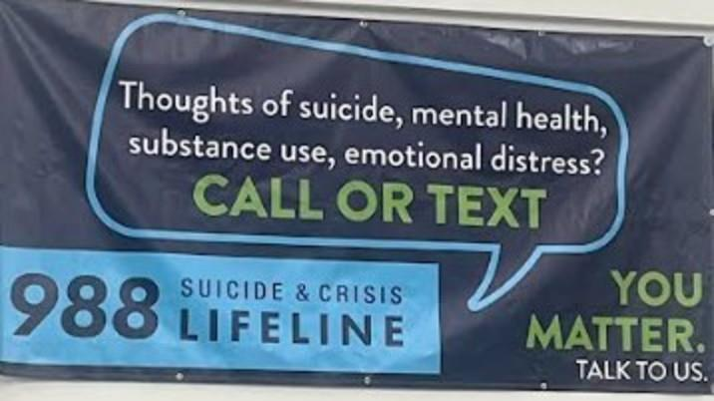

Slide 19

Thank you

